Slide 1

Learning the Lexicon
Language in Lyrics

Slide 2
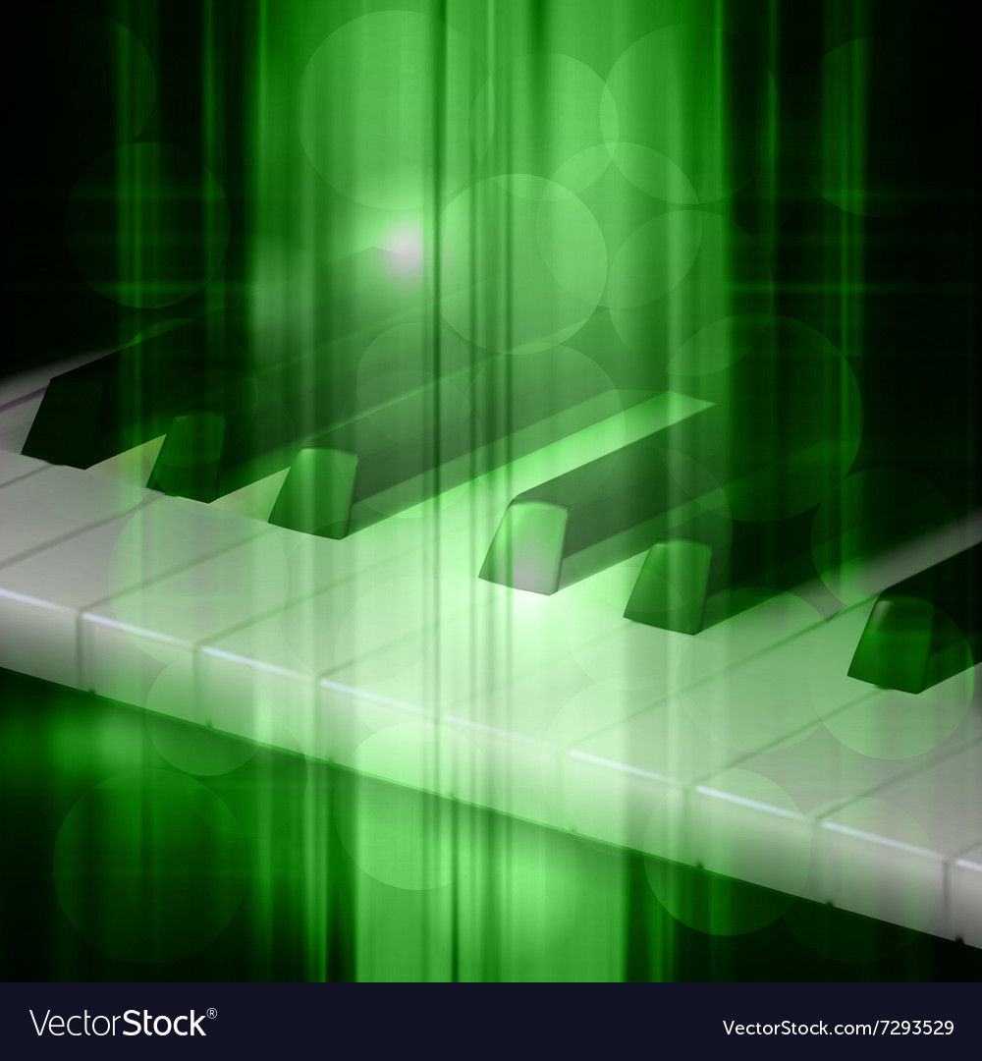
Motivation What goes into the language of music? Are there specific trends by time or genre?

Slide 3
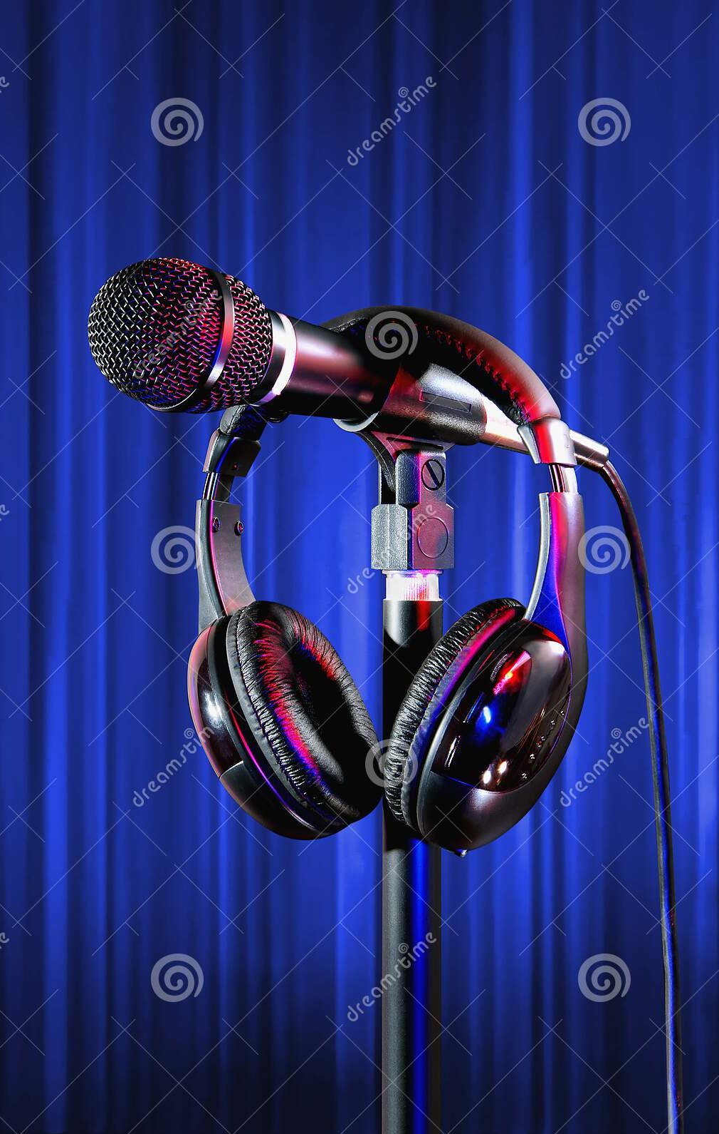
Motivation
Business Uses:
Compile genre or time specific vocabularies to create more authentic pieces rooted in those periods
Map music topic trends over time to further explore and analyze
Help narrow topic field for song creation

Slide 4

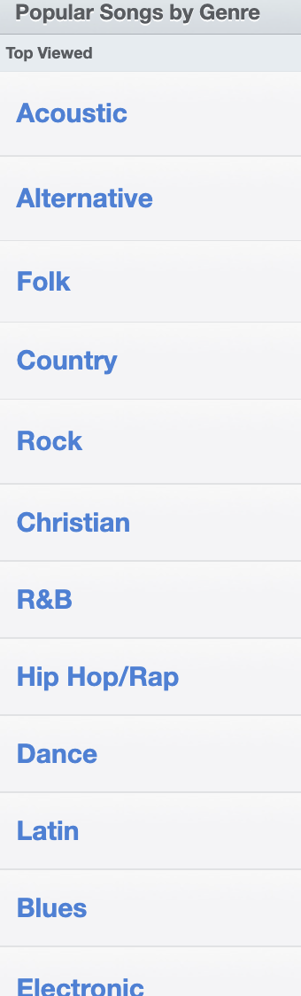
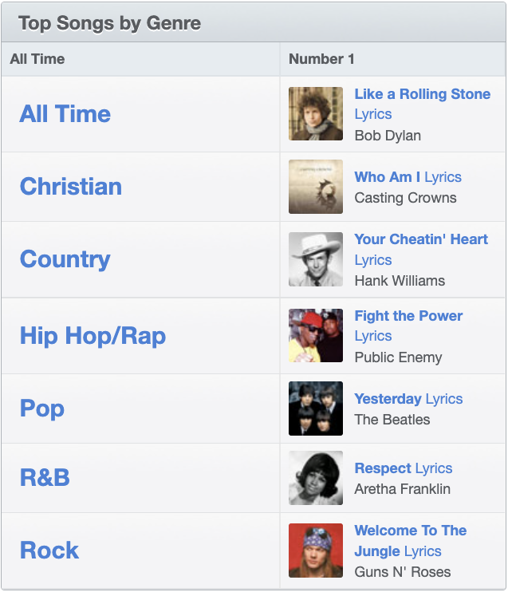
DatA Acquisition

Slide 5
Analysis Strategy

Slide 6
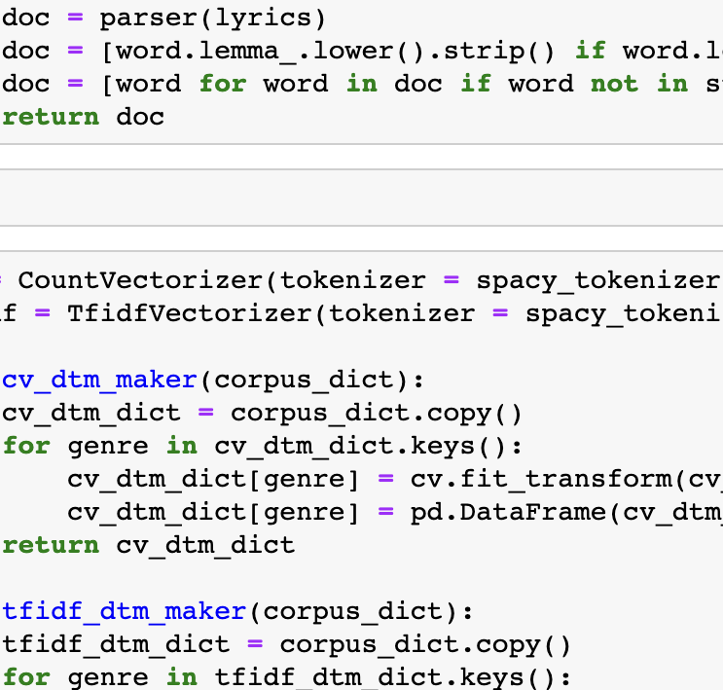
Data Selection
TF-IDF for tokenization
spaCy used to customize
NME for topic modeling
Preprocessing Choices
Maintained traditional and variant spellings
TF-IDF for ease of readability

Slide 7
Output, Examples Usage Options
Subsegment | Topic | Associated Words
2010’s Topic 1 | Loneliness/ Longing | night, thing, feel, rain, body, look
2010’s Topic 2 | Anger/Desire | broken, edge, want, run, tonight
1990’s | Party/Dancing | wanna, rock, money, pump, beat, people
1950’s | Romance/Love | love, baby, long, know, heart
R&B | Club | hey, dance, music, ho, ha

Slide 8
Conclusions & Further Work

Slide 9
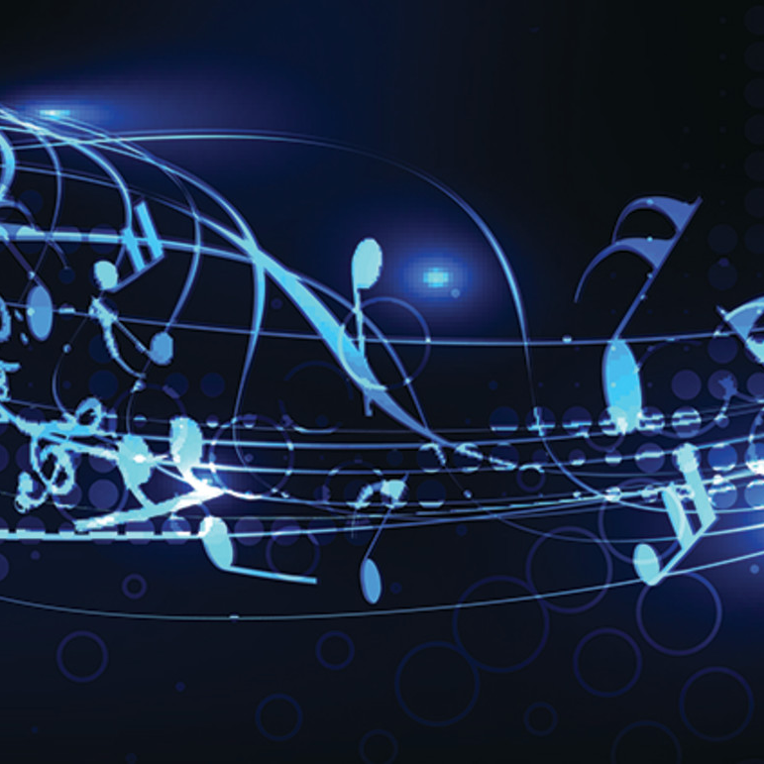
Reusability
Pipeline is already constructed, and a basic interface such as Tableau could add a lot in the way of customized reuse
More Nuance
Sentiment analysis could add deeper understanding to generally vague language choices
Continued segmentation
Further exploration could be done with each genre being explored on a decade level instead of decades only containing mixed data

Slide 10
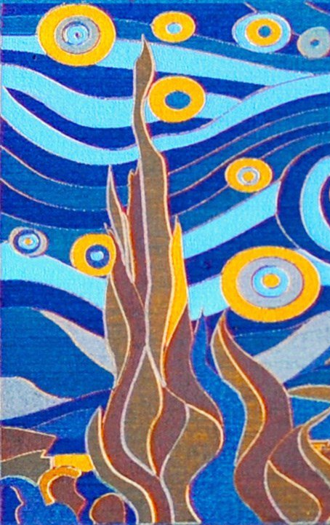
Any Questions?

